Slide 1
GROUP2 ‘Data Science’ {
adatech.ipynb
santander.coders_2023
[Brazil]
< Mercado de Trabalho >
< Anna Clara Amâncio,
Ingrid Guimarães,
Jaisson de Azevedo,
Jorge Dantas,
Lucas Cruz,
Mariah Moreira>
}
Data Science
tecnicas_de_programacao_I.PY

Slide 2
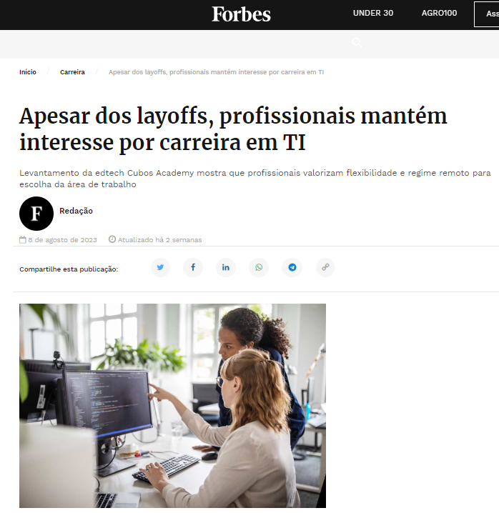
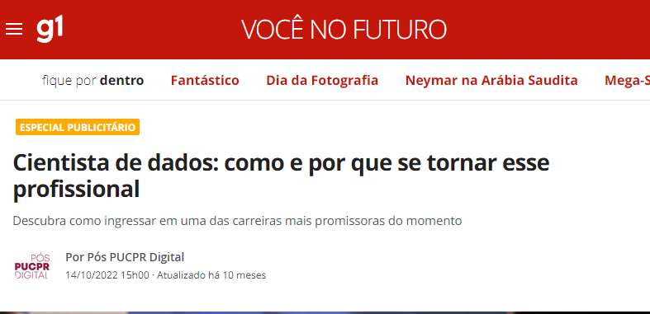
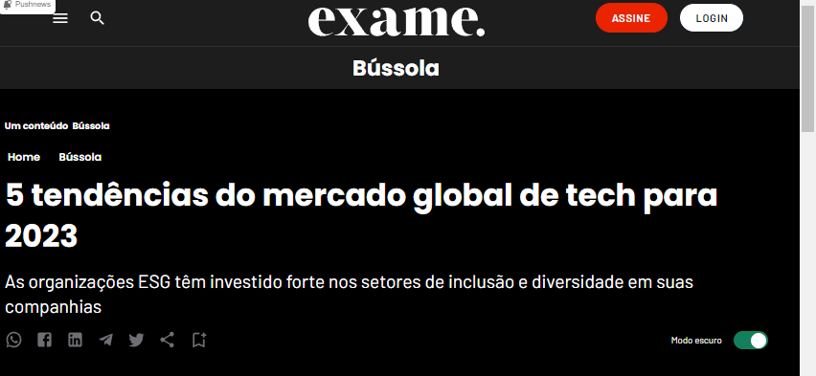
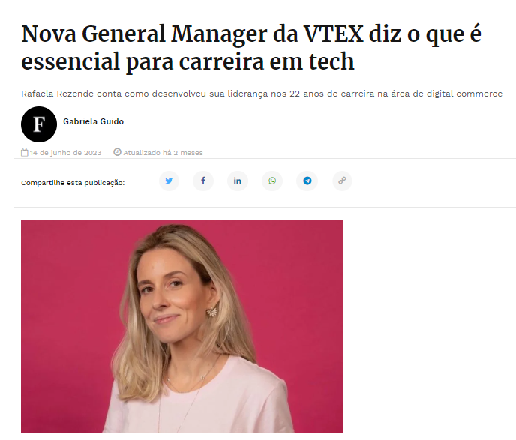


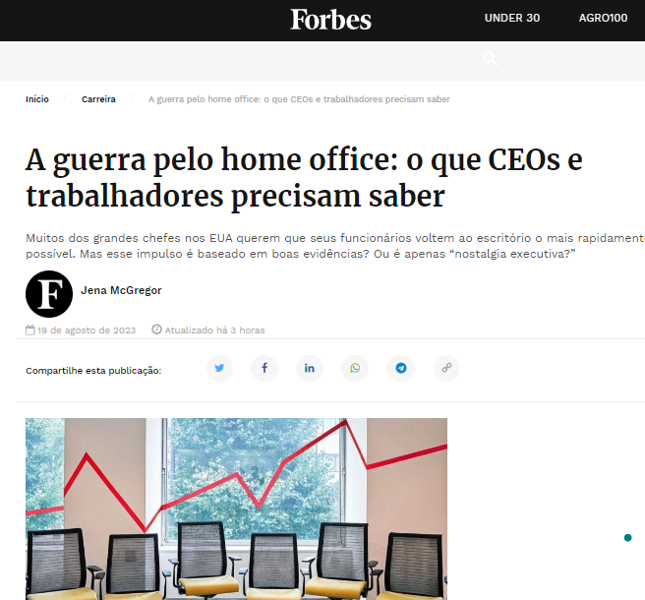
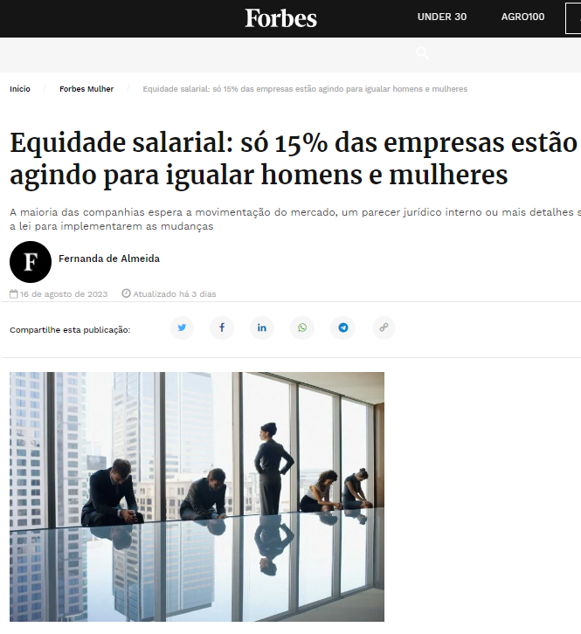
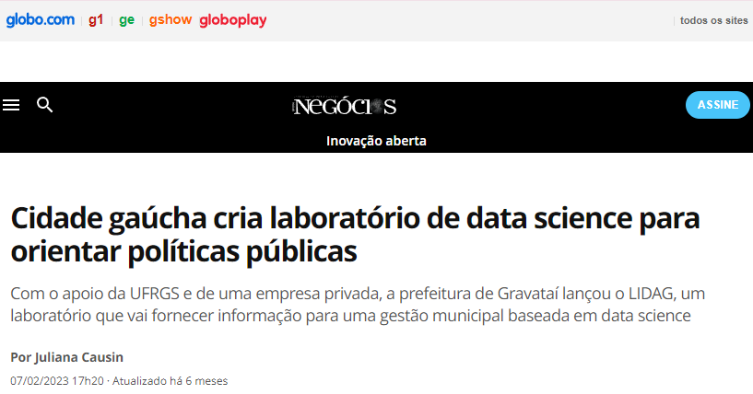
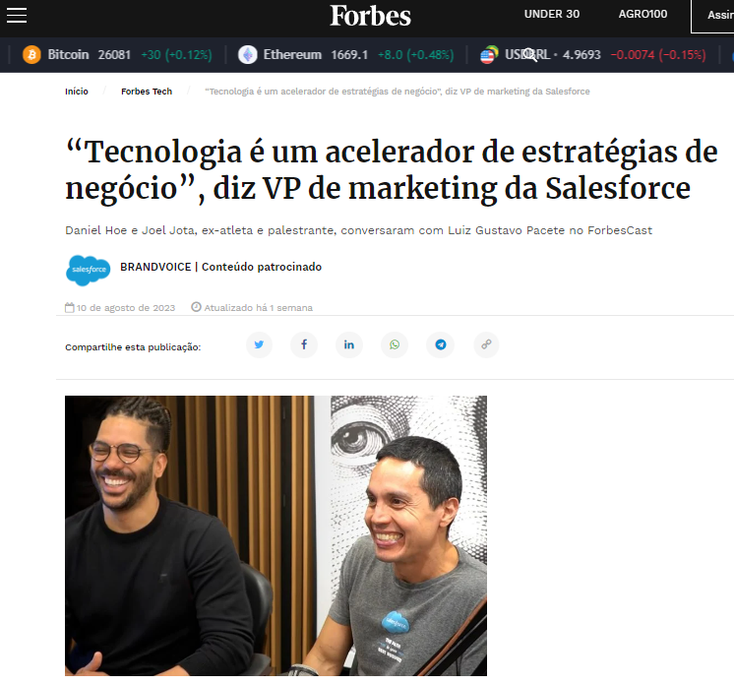
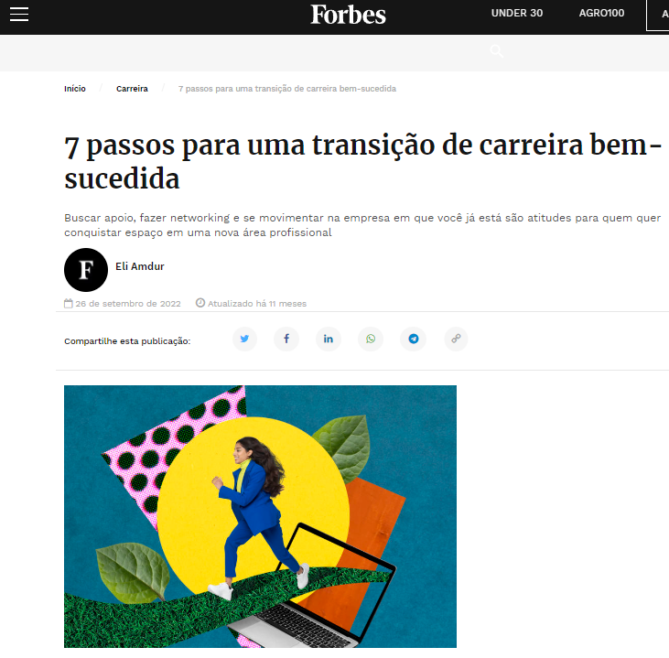
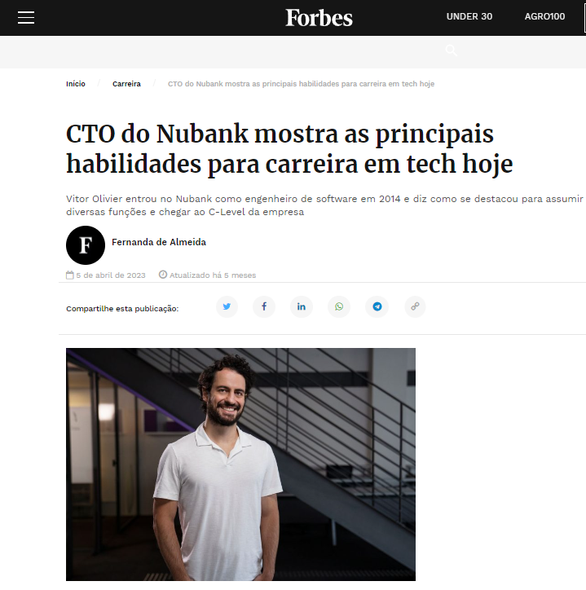
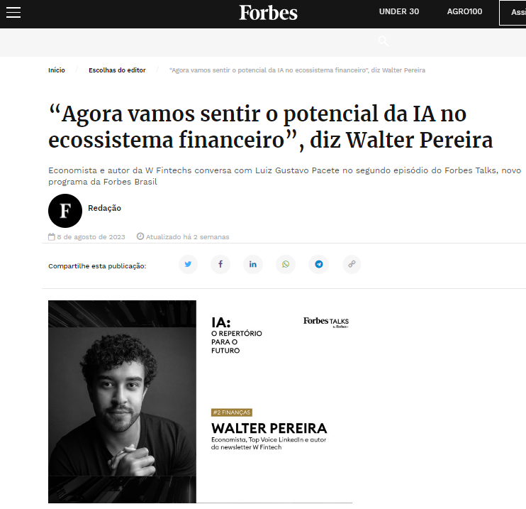
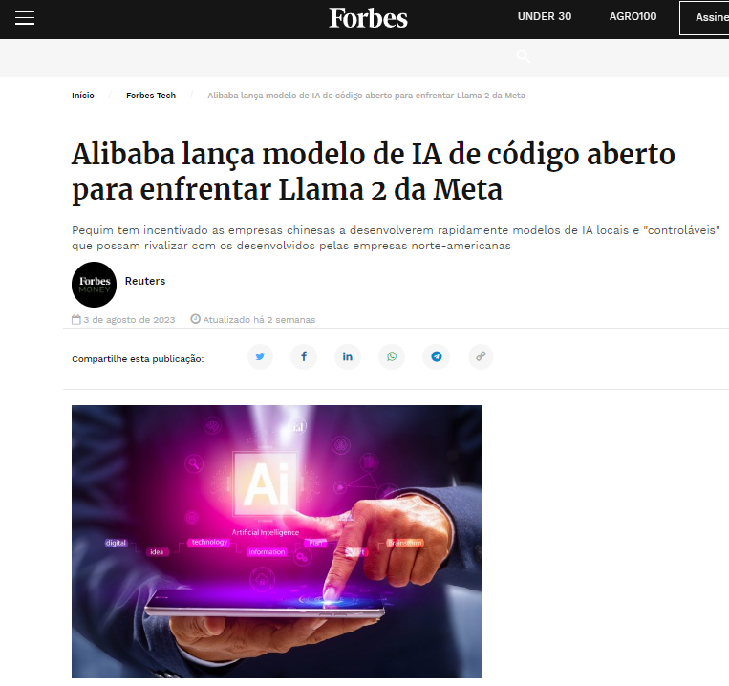
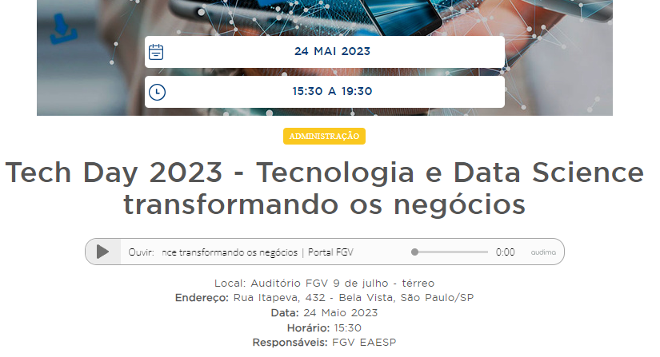
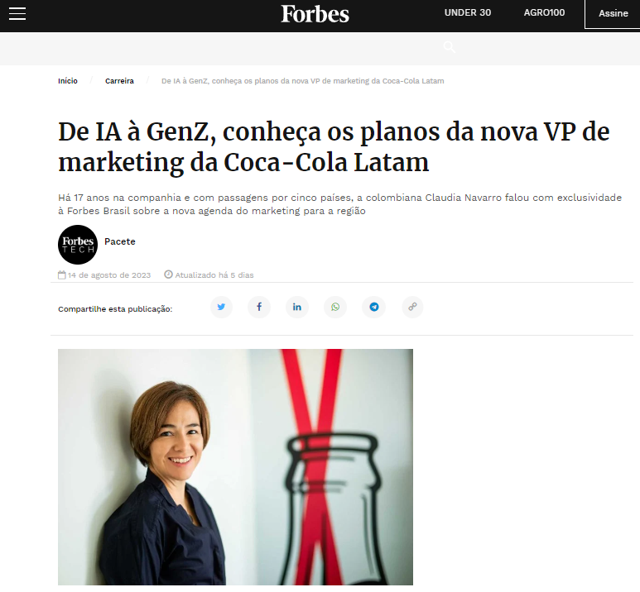
1 Data Science {Introduction}
abertura.ppt
introduction.ipynb
Programming Python
State_of_data_2022.csv

Slide 3


2 State of Data Brazil - 2022
1
2
3
4
5
6
7
8
9
10
11
12
É o mapeamento do mercado de trabalho brasileiro na área de dados desenvolvido pela Data Hackers, a maior comunidade brasileira de dados, em parceria com a Bain & Company.
O questionário foi dividido em 8 partes, e dentro de cada uma das partes temos as perguntas e opções de escolha.
Parte 1 - Dados demográficos
Parte 2 - Dados sobre carreira
Parte 3 - Desafios dos gestores de times de dados
Parte 4 - Conhecimentos na área de dados
Parte 5 - Objetivos na área de dados
Parte 6 - Conhecimentos em Engenharia de Dados/DE
Parte 7 - Conhecimentos em Análise de Dados/DA
Parte 8 - Conhecimentos em Ciências de Dados/DS
Cada pergunta é dividida em Parte, Letra da Pergunta, Número da Opção escolhida Exemplo: P3a_1 = Parte 3, pergunta (a), opção (1)

Slide 4
SyntaxError:
State_of_data_2022.html
Problems_and_solutions.csv
/01
< Base de dados extensa shape(4271,32);
/02
< Questões de múltipla escolha (verdadeiro e falso);
/03
< Respostas não obrigatórias (valores vazios);
/04
< Respostas abertas;
Solutions
/01
< Compreensão da base;
Programming Language

Slide 5
SyntaxError:
State_of_data_2022.html
Problems_and_solutions.csv
/01
Mercury
< It’s the closest planet to the Sun
/02
Venus
< Venus is the second planet from the Sun
/03
Mars
< Mars is actually a very cold place
/04
Jupiter
< It’s the biggest planet of them all
/05
Saturn
< It’s composed of hydrogen and helium
/06
Neptune
< Neptune is far away from Earth
Programming Language

Slide 6
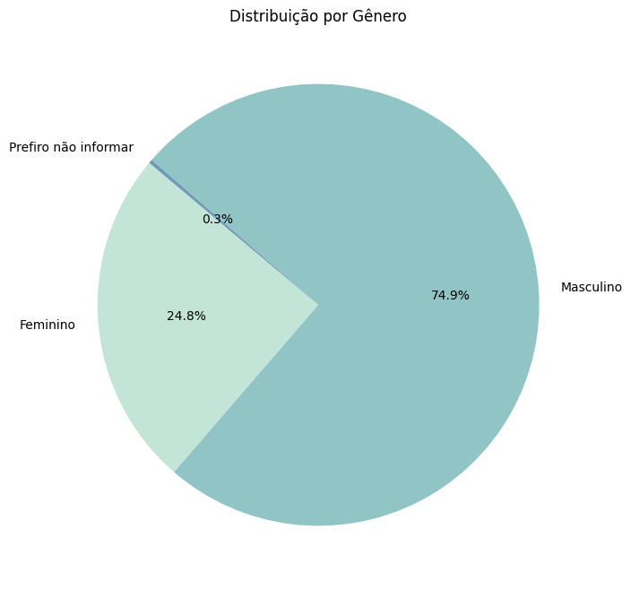
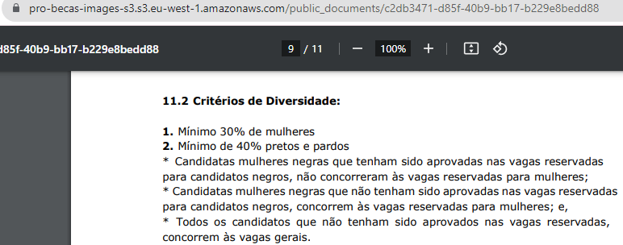
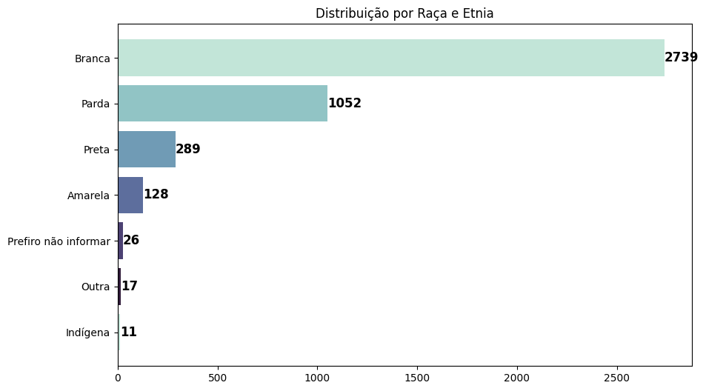
Dados Demograficos {infographics}
Problems_and_solutions.ipynb
db_demographics.csv
< Menos de um terço das pessoas que atuam na área de dados são do genero feminino.
< Maior representatividade é por pessoas autodeclaradas brancas
Importancia dos
Critérios de Diversidade
Programming Python

Slide 7
Programming language {infographics}
Problems_and_solutions.ipynb
db_demographics.csv
Venus
25%
< It’s the second planet from the Sun
25%
Neptune
< Neptune is very far from Earth
Saturn has several rings
Place 1
Place 2
Programming Language

Slide 8
Programming language {infographics}
5/6
2/6
3/6
6/6
forbeginners.html
workshop.css
Mercury
Jupiter
< Mercury is the closest planet to the Sun >
< Jupiter is a gas giant and the biggest planet >
Saturn
Venus
< Saturn is a gas giant and has several rings >
< Venus has a nice name and high temperatures >
Programming Language

Slide 9
Programming language {infographics}
forbeginners.html
workshop.css
Jupiter
Mercury
Earth
< This planet is a gas giant
< It’s the smallest planet
< Earth is where we all live on
Programming Language

Slide 10
Programming language {infographics}
/01
40%
/02
60%
forbeginners.html
workshop.css
Jupiter
< Jupiter is the biggest planet of them all
Saturn
Saturn is a gas giant and has several rings. It’s composed mostly of hydrogen and helium. It was named after the Roman god of wealth
Venus
< Venus is the second planet from the Sun
Programming Language

Slide 11
Programming language {infographics}
/01
/02
/03
4/9
7/10
6/10
forbeginners.html
workshop.css
Jupiter
Mars
Venus
< It’s the biggest planet of them all
< Mars is actually a very cold place
< It’s the second planet from Sun
Programming Language

Slide 12
Programming language {infographics}
25%
50%
75%
90%
forbeginners.html
workshop.css
Mercury
Mars
< Mercury is a small planet
< Mars is actually cold
Earth
Jupiter
< Earth is where we all live on
< It’s the biggest planet
Programming Language

Slide 13
Programming language {infographics}
/2000
/2022
/1900
/2020
forbeginners.html
workshop.css
Mercury
Saturn
< It’s the smallest planet
< Saturn is a gas giant
Venus
Neptune
< Venus has a beautiful name
< It’s far away from Earth
Programming Language

Slide 14
Programming language {infographics}
10%
35%
25%
30%
forbeginners.html
workshop.css
Mars
Mercury
< Despite being red, Mars is cold
< Mercury is the smallest planet
Jupiter
Earth
< It’s the biggest planet
Saturn has several rings
< Earth is where we all live on
Programming Language

Slide 15
Programming language {infographics}
70%
25%
45%
forbeginners.html
workshop.css
Venus
< Venus is the second planet from the Sun
Jupiter
Neptune
< Jupiter is the biggest planet of them all
< This planet is far away from our planet called Earth
Programming Language

Slide 16
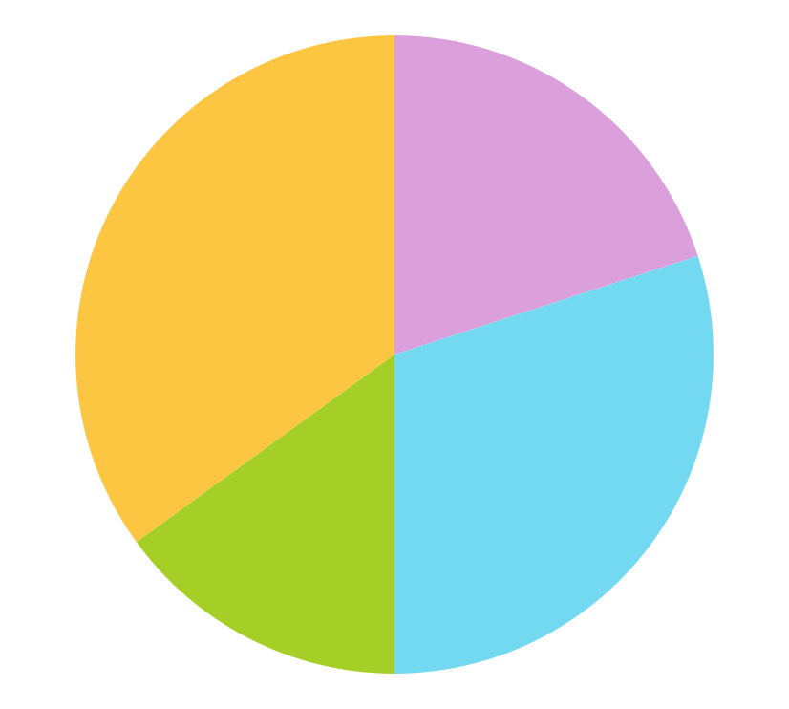
Programming language {infographics}
35%
20%
15%
30%
forbeginners.html
workshop.css
Mars
Mercury
< Mars is actually cold
< Mercury is the smallest planet
Jupiter
Earth
< It’s the biggest planet
< Earth is where we all live on
Follow the link in the graph to modify its data and then paste the new one here. For more info, click here
Programming Language

Slide 17
SyntaxError:
State_of_data_2022.html
Problems_and_solutions.csv
/01
Mercury
< It’s the closest planet to the Sun
/02
Venus
< Venus is the second planet from the Sun
/03
Mars
< Mars is actually a very cold place
/04
Jupiter
< It’s the biggest planet of them all
/05
Saturn
< It’s composed of hydrogen and helium
/06
Neptune
< Neptune is far away from Earth
Programming Language

Slide 18
Programming language {infographics}
75%
90%
50%
25%
forbeginners.html
workshop.css
Mercury
Venus
< It’s the smallest planet
< Venus has a beautiful name
Mars
Jupiter
< Mars is actually cold
< It’s the biggest planet
Programming Language

Slide 19
Programming language {infographics}
75%
50%
25%
forbeginners.html
workshop.css
Jupiter
Neptune
< Jupiter is the biggest planet
< This planet is far away from Earth
Venus
< It’s the second planet from the Sun
Programming Language

Slide 20
Programming language {infographics}
30%
70%
50%
forbeginners.html
workshop.css
Saturn
Venus
Jupiter
< It’s composed mostly of hydrogen and helium
< Venus is the second planet from the Sun
< Jupiter is the biggest planet of them all
Programming Language

Slide 21
Programming language {infographics}
forbeginners.html
workshop.css
< It’s the closest planet to the Sun
Mercury
Venus
< Venus is the second planet from the Sun
< Mars is actually a very cold place
Mars
Neptune
< Neptune is far away from Earth
Programming Language

Slide 22
Programming language {infographics}
forbeginners.html
workshop.css
Mercury
50%
< Mercury is very small
Venus
65%
< Venus has a beautiful name
Mars
20%
< Mars is a very cold place
Jupiter
30%
< Jupiter is a gas giant
Saturn
80%
< Saturn has several rings
Neptune
100%
< Neptune is a very cold place
Programming Language

Slide 23
Programming language {infographics}
forbeginners.html
workshop.css
Mercury
Jupiter
< Mercury is the closest planet to the Sun >
< Jupiter is a gas giant and the biggest planet >
Saturn
Venus
< Saturn is a gas giant and has several rings >
< Venus has a nice name and high temperatures >
Programming Language

Slide 24
Programming language {infographics}
/01
/02
50%
80%
forbeginners.html
workshop.css
Venus
Saturn
< Venus is the second planet from the Sun
< Saturn is composed of hydrogen and helium
/html.
/html.
Programming Language

Slide 25
Programming language {infographics}
forbeginners.html
workshop.css
Venus
< This planet has a very beautiful name
Saturn
< Saturn is a gas giant and has rings
Mercury
< Mercury is the closest planet to the Sun
Mars
< Despite being red, Mars is a cold place
Programming Language

Slide 26
Programming language {infographics}
50%
90%
forbeginners.html
workshop.css
Mercury
Venus
< It’s closest planet to the Sun
< It’s the smallest planet of all
< Mercury is very small
< Mercury is a small planet
< It’s the second planet from Sun
< Venus has a toxic atmosphere
< Venus has extreme temperatures
< Venus is a very hot planet
/html.
/html.
Programming Language

Slide 27
Programming language {infographics}
/01
/02
forbeginners.html
workshop.css
Earth
Mars
< We all live on Earth
< Mars is actually cold
Mercury
Venus
Saturn
Neptune
< Mercury is a small planet
< Venus has a beautiful name
< Saturn is a gas giant
< It’s far away from Earth
Programming Language

Slide 28
Programming language {infographics}
forbeginners.html
workshop.css
Mercury
65%
< Mercury is very small
Mars
20%
< Mars is a very cold place
Jupiter
30%
< Jupiter is a gas giant
Conclusions
< Venus has a beautiful name and is the second planet from the Sun. It is terribly hot, even hotter than Mercury, and its atmosphere is toxic
Programming Language

Slide 29
Programming language {infographics}
forbeginners.html
workshop.css
Neptune
< It’s far away from Earth
Mercury
Venus
Saturn
< Mercury is a small planet
< Venus has a beautiful name
< It’s composed of hydrogen
Programming Language

Slide 30
Programming language {infographics}
80%
45%
50%
forbeginners.html
workshop.css
Venus
< Venus has a beautiful name
Mars
< Despite being red, it’s cold
Neptune
< It’s far away from Earth
/2020
/2021
/2022
Programming Language

Slide 31
Programming language {infographics}
90%
75%
60%
forbeginners.html
workshop.css
Jupiter
Venus
Neptune
< Jupiter is the biggest planet
< It’s the second planet from the Sun
< This planet is far away from Earth
Programming Language

Slide 32
Programming language {infographics}
40%
60%
forbeginners.html
workshop.css
Saturn
Venus
< Saturn is a gas giant and has several rings. It’s composed mainly of hydrogen and helium. It was named after the Roman god of wealth and agriculture
< Venus has a beautiful name and is the second planet from the Sun. It’s hot, even hotter than Mercury, and its atmosphere is toxic
Programming Language

Slide 33
Programming language {infographics}
forbeginners.html
workshop.css
 | Mon | Tue | Wed | Thu | Fri
Project 01
Project 02
Project 03
Project 04
Project 05
Project 01
Project 02
Project 03
Project 04
Project 05
Programming Language

Slide 34
Programming language {infographics}
forbeginners.html
workshop.css
December
Mon | Tue | Wed | Thu | Fri | Sat | Sun
 |  | 1 | 2 | 3 | 4 | 5
6 | 7 | 8 | 9 | 10 | 11 | 12
13 | 14 | 15 | 16 | 17 | 18 | 19
20 | 21 | 22 | 23 | 24 | 25 | 26
27 | 28 | 29 | 30 | 31
Activity 1
Activity 2
Activity 3
Programming Language

Slide 35
Programming language {infographics}
forbeginners.html
workshop.css
Venus
Mars
< Mercury is the smallest planet of them all
< Venus is the second planet from the Sun
< Despite being red, Mars is a very cold planet
< Neptune is the farthest planet from the Sun
< Saturn is a gas giant and has several rings
< Jupiter is a gas giant and the biggest planet
Programming Language

Slide 36
Programming language {infographics}
forbeginners.html
workshop.css
< Mercury is the smallest planet of them all
< Venus is the second planet from the Sun
< Despite being red, Mars is a very cold planet
< Jupiter is the biggest planet of them all
< Saturn is a gas giant and has several rings
< Neptune is the farthest planet from the Sun
Programming Language

Slide 37
Instructions for use
If you have a free account, in order to use this template, you must credit Slidesgo in your final presentation. Please refer to the next slide to read the instructions for premium users.
As a Free user, you are allowed to:
- Modify this template.
- Use it for both personal and commercial projects.
You are not allowed to:
- Sublicense, sell or rent any of Slidesgo Content (or a modified version of Slidesgo Content).
- Distribute Slidesgo Content unless it has been expressly authorized by Slidesgo.
- Include Slidesgo Content in an online or offline database or file.
- Offer Slidesgo templates (or modified versions of Slidesgo templates) for download.
- Acquire the copyright of Slidesgo Content.
For more information about editing slides, please read our FAQs or visit our blog:
https://slidesgo.com/faqs and https://slidesgo.com/slidesgo-school

Slide 38
Instructions for use (premium users)
As a Premium user, you can use this template without attributing Slidesgo.
You are allowed to:
Modify this template.
Use it for both personal and commercial purposes.
Share this template in an editable format with people who are not part of your team.
You are not allowed to:
Sublicense, sell or rent this Slidesgo Template (or a modified version of this Slidesgo Template).
Distribute this Slidesgo Template (or a modified version of this Slidesgo Template) or include it in a database or in any other product or service that offers downloadable images, icons or presentations that may be subject to distribution or resale.
Use any of the elements that are part of this Slidesgo Template in an isolated and separated way from this Template.
Register any of the elements that are part of this template as a trademark or logo, or register it as a work in an intellectual property registry or similar.
For more information about editing slides, please read our FAQs or visit our blog:
https://slidesgo.com/faqs and https://slidesgo.com/slidesgo-school

Slide 39
Infographics
You can add and edit some infographics to your presentation to present your data in a visual way.
Choose your favourite infographic and insert it in your presentation using Ctrl C + Ctrl V or Cmd C + Cmd V in Mac.
Select one of the parts and ungroup it by right-clicking and choosing “Ungroup”.
Change the color by clicking on the paint bucket.
Then resize the element by clicking and dragging one of the square-shaped points of its bounding box (the cursor should look like a double-headed arrow). Remember to hold Shift while dragging to keep the proportions.
Group the elements again by selecting them, right-clicking and choosing “Group”.
Repeat the steps above with the other parts and when you’re done editing, copy the end result and paste it into your presentation.
Remember to choose the “Keep source formatting” option so that it keeps the design. For more info, please visit our blog.

